Slide 1
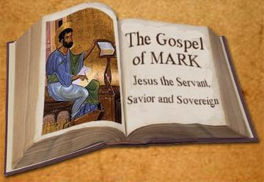
The gospel of mark
Year 3 Bible study Competition Revision 2017

Slide 2
Choose The Correct Answer
1- John the Baptist was clothed with
Camel’s hair
Oxen’s hair
Cattle’s hair
2- The book of Mark is the __________ book of the New Testament.
First
Second
Third

Slide 3
Choose The Correct Answer
1- John the Baptist was clothed with
Camel’s hair
Oxen’s hair
Cattle’s hair
2- The book of Mark is the __________ book of the New Testament.
First
Second
Third

Slide 4
3- John the Baptist came:
Baptising in the wilderness
Preaching a Baptism of Repentance for the remission of sins.
All of the above
4- “The time is fulfilled, and the Kingdom of God is at hand. Repent, and believe in the gospel.” Who said this?
John The Baptist
Herod
Jesus

Slide 5
3- John the Baptist came:
Baptising in the wilderness
Preaching a Baptism of Repentance for the remission of sins.
All of the above
4- “The time is fulfilled, and the Kingdom of God is at hand. Repent, and believe in the gospel.” Who said this?
John The Baptist
Herod
Jesus

Slide 6
5- How long was Jesus tempted in the wilderness:
One day
Twelve days.
Forty days
6- What did Jesus do for Peter’s mother-in-law?
Stopped her bleeding
Healed her withered arm
Healed her from a fever

Slide 7
5- How long was Jesus tempted in the wilderness:
One day
Twelve days.
Forty days
6- 6- What did Jesus do for Peter’s mother-in-law?
Stopped her bleeding
Healed her withered arm
Healed her from a fever

Slide 8
7- What was the first thing that Jesus said to the paralysed man when he was lowered down through the roof:
Go and sin no more
Take up your bed and walk
Your sins are forgiven you
8- Jesus healed a woman who was bleeding for many years. How many years did she bleed for?
Seven years
Twelve years
Thirty-eight years

Slide 9
7- What was the first thing that Jesus said to the paralysed man when he was lowered down through the roof :
Go and sin no more
Take up your bed and walk
Your sins are forgiven you
8- Jesus healed a woman who was bleeding for many years. How many years did she bleed for?
Seven years
Twelve years
Thirty-eight years

Slide 10
9- Whose daughter did Jesus bring back to life?
Jairus’
Nobleman’s
Widow of Nain’s
10- Who did Herod think Jesus was?
Elijah
John the Baptist
Isaiah

Slide 11
9- Whose daughter did Jesus bring back to life?
Jairus’
Nobleman’s
Widow of Nain’s
10- Who did Herod think Jesus was?
Elijah
John the Baptist
Isaiah

Slide 12
11- Jesus talked about taking up the cross and following Him, He said:
“Whoever desires to come after Me, let him deny himself, and take up his cross, and follow Me.
For whoever desires to save his life will lose it, but whoever loses his life for My sake and the gospel’s will save it.
For what will it profit a man if he gains the whole world, and loses his own soul?
All of the above

Slide 13
11- Jesus talked about Taking Up the Cross and Follow Him, He said:
“Whoever desires to come after Me, let him deny himself, and take up his cross, and follow Me.
For whoever desires to save his life will lose it, but whoever loses his life for My sake and the gospel’s will save it.
For what will it profit a man if he gains the whole world, and loses his own soul?
All of the above

Slide 14
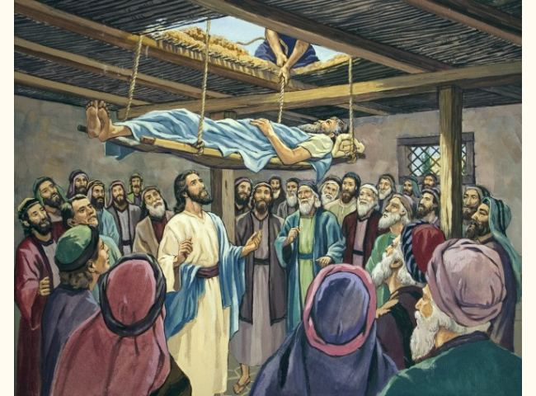
12- In the below picture,
Who is the man lying on the bed?
Who’s letting the bed down?
Why did they do that?

Slide 15
12- In the below picture,
Who is the man lying on the bed? A paralytic man
Who’s letting the bed down? The paralytic man’s four friends
Why did they do that? The room was too crowded and this was the only way to bring the paralytic man to Jesus to be healed.

Slide 16
13- Match the following words to their meanings and pictures. (The first one has been done for you)

Slide 17
13- Match the following words to their meanings and pictures. (The first one has been done for you)
5- scribes
2- Pharisees
4- Physician
1- paralytic

Slide 18
Fill in the missing words.
14-Jesus said, “Here are My mother and My brothers! For whoever does _______is My brother and My sister and mother.”
15-There is nothing that enters a man from ______ which can defile him; but the things which come ____ of him, those are the things that _______ _ ____ . If anyone has ____ to hear, let him hear!”

Slide 19
Complete:
14- Jesus said, “Here are My mother and My brothers! For whoever does the Will of God is My brother and My sister and mother.”
15- There is nothing that enters a man from outside which can defile him; but the things which come out of him, those are the things that defile a man. If anyone has ears to hear, let him hear!”

Slide 20
16.Match
A The Sower is | C | immediately receive it with gladness; ¹⁷ and they have no root in themselves, and so endure only for a time. Afterward, when tribulation or persecution arises for the word’s sake, immediately they stumble.
B these are the ones by the wayside where the word is sown. |  | God the Word
C the ones sown on stony ground who, when they hear the word, |  | they are the ones who hear the word, ¹⁹ and the cares of this world, the deceitfulness of riches, and the desires for other things entering in choke the word, and it becomes unfruitful.
D Now these are the ones sown among thorns; |  | those who hear the word, accept it, and bear fruit: some thirtyfold, some sixty, and some a hundred.”
E But these are the ones sown on good ground, |  | When they hear, Satan comes immediately and takes away the word that was sown in their hearts.

Slide 21
16.Match
A The Sower is | C | immediately receive it with gladness; ¹⁷ and they have no root in themselves, and so endure only for a time. Afterward, when tribulation or persecution arises for the word’s sake, immediately they stumble.
B these are the ones by the wayside where the word is sown. | A | God the Word
C the ones sown on stony ground who, when they hear the word, | D | they are the ones who hear the word, ¹⁹ and the cares of this world, the deceitfulness of riches, and the desires for other things entering in choke the word, and it becomes unfruitful.
D Now these are the ones sown among thorns; | E | those who hear the word, accept it, and bear fruit: some thirtyfold, some sixty, and some a hundred.”
E But these are the ones sown on good ground, | B | When they hear, Satan comes immediately and takes away the word that was sown in their hearts.

Slide 22
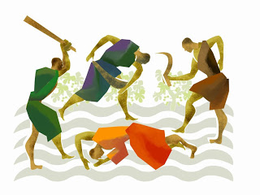
17.Which is the correct answer:
Jesus spoke of a master who sent out his servants to collect what was due to him from his tenants.
Instead of receiving the money, the servants were beaten and then sent back empty handed!
The master represents:
God the Son, or
God the Father

Slide 23
17.Which is the correct answer:
Jesus spoke of a master who sent out his servants to collect what was due to him from his tenants.
Instead of receiving the money, the servants were beaten and then sent back empty handed!
The master represents:
God the Son, or
God the Father

Slide 24
Choose the correct definition:
18.Jesus said, “If you can believe, all things are (possible / impossible) to him who believes.”
19. And He sat down, called the twelve, and said to them, “If anyone desires to be first, he shall be (first / last) of all and (servant / master) of all.”
20. (Salt / Sugar) is good, but if the (salt / sugar) loses its flavour, how will you season it? Have salt in yourselves, and have peace with one another.”

Slide 25
Choose the correct definition:
18.Jesus said, “If you can believe, all things are (possible / impossible) to him who believes.”
19. And He sat down, called the twelve, and said to them, “If anyone desires to be first, he shall be (first / last) of all and (servant / master) of all.”
20. (Salt / Sugar) is good, but if the (salt / sugar) loses its flavour, how will you season it? Have salt in yourselves, and have peace with one another.”

Slide 26
Match the quotes with the characters
21. “The Son of Man is being betrayed into the hands of men, and they will kill Him. And after He is killed, He will rise the third day.”
22. “There comes One after me who is mightier than I, whose sandal strap I am not worthy to stoop down and loose. I indeed baptized you with water, but He will baptize you with the Holy Spirit.”
23.“Yes, Lord, yet even the little dogs under the table eat from the children’s crumbs.”
24.“Let us alone! What have we to do with You, Jesus of Nazareth? Did You come to destroy us? I know who You are—the Holy One of God!”
The mother of the young girl who had an unclean spirit
Jesus
The unclean spirit
John The Baptist

Slide 27
Match the quotes with the characters
21. “The Son of Man is being betrayed into the hands of men, and they will kill Him. And after He is killed, He will rise the third day.”
22. “There comes One after me who is mightier than I, whose sandal strap I am not worthy to stoop down and loose. I indeed baptized you with water, but He will baptize you with the Holy Spirit.”
23.“Yes, Lord, yet even the little dogs under the table eat from the children’s crumbs.”
24.“Let us alone! What have we to do with You, Jesus of Nazareth? Did You come to destroy us? I know who You are—the Holy One of God!”
23. The mother of the young girl who had anunclean spirit
21. Jesus
24. The unclean spirit
22. John The Baptist

Slide 28
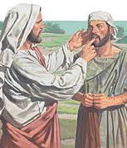
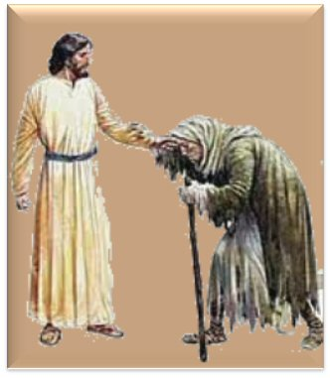
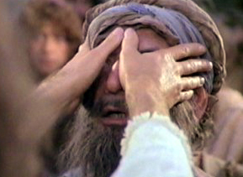
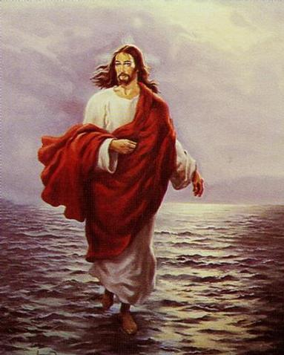
25.Match quotes with photos
“Be of good cheer! It is I; do not be afraid.” Mark 6: 50
Then, looking up to heaven, He sighed, and said to him, “Ephphatha,” that is, “Be opened.” Mark 7:34
Then Jesus, moved with compassion, stretched out His hand and touched him, and said to him, “I am willing; be cleansed.” Mark 1:41
A Blind Man Healed at Bethsaida (Mark 8: 22- 25)
A
B
C
D

Slide 29
25.Match quotes with photos
“Be of good cheer! It is I; do not be afraid.” Mark 6: 50
Then, looking up to heaven, He sighed, and said to him, “Ephphatha,” that is, “Be opened.” Mark 7:34
Then Jesus, moved with compassion, stretched out His hand and touched him, and said to him, “I am willing; be cleansed.” Mark 1:41
A Blind Man Healed at Bethsaida (Mark 8: 22- 25)
D
A
B
C

Slide 30
Q26. Mark 8: 27 tells us:
“He (Jesus” asked His disciples, saying to them, “Who do men say that I am?” “
Who answered:
“John the Baptist; but some say, Elijah; and others, one of the prophets.”
“You are the Christ”

Slide 31
Q26. Mark 8: 27 tells us:
“He (Jesus” asked His disciples, saying to them, “Who do men say that I am?” “
Who answered:
“John the Baptist; but some say, Elijah; and others, one of the prophets.” The disciples
“You are the Christ” Peter

Slide 32
27. Look up verse
Mark 6:49-51

Slide 33
27. Look up verse
Mark 6:49-51
⁴⁹ And when they saw Him walking on the sea, they supposed it was a ghost, and cried out; ⁵⁰ for they all saw Him and were troubled. But immediately He talked with them and said to them, “Be of good cheer! It is I; do not be afraid.” ⁵¹ Then He went up into the boat to them, and the wind ceased. And they were greatly amazed in themselves beyond measure, and marveled.

Slide 34
Choose The Correct Answer:
28- When Jesus transfigured (clothes became shining), He was with:
Peter, Philip and John
Peter, James and John
Peter, Matthew and James
29- Who appeared with Jesus in the Transfiguration?
Elijah and Moses
Elijah and David
Samuel and David

Slide 35
Choose The Correct Answer:
28- When Jesus transfigured (clothes became shining), He was with:
Peter, Philip and John
Peter, James and John
Peter, Matthew and James
29- Who appeared with Jesus in the Transfiguration?
Elijah and Moses
Elijah and David
Samuel and David

Slide 36
30- What do you think “… the hardness of your heart… “ means?
We do not focus on obeying God
a disease of the heart
the heart becomes like a rock
31- What did Jesus say about receiving the kingdom of God?
Only adults can receive the Kingdom of God
Only children can receive the kingdom of God
Children are trusting, forgiving and love their parents. If everyone, including adults, trust and obey God like children do, they can also receive the Kingdom of God.

Slide 37
30- What do you think “… the hardness of your heart… “ means?
We do not focus on obeying God
a disease of the heart
the heart becomes like a rock
31- What did Jesus say about receiving the Kingdom of God?
Only adults can receive the Kingdom of God
Only children can receive the kingdom of God
Children are trusting, forgiving and love their parents. If everyone, including adults, trust and obey God like children do, they can also receive the Kingdom of God.

Slide 38
32- In the story of the poor widow who put 2 coins into the treasury, what is the lesson that Christ was giving to His disciples?
It is more important to give with love than to give because you have to
Rich people should give more than poor people
Poor people should give only 2 coins
Rich people like their coins more than poor people

Slide 39
32- In the story of the poor widow who put 2 coins into the treasury, what is the lesson that Christ was giving to His disciples?
It is more important to give with love than to give because you have to
Rich people should give more than poor people
Poor people should give only 2 coins
Rich people like their coins more than poor people

Slide 40
33- Why was Jesus happy with the woman who broke the flask of expensive oil and poured it on His head?
Because it was tradition to anoint a person’s body before they were buried
Because what she did was an act of repentance
Because what she did was an act of love
All of the above

Slide 41
33- Why was Jesus happy with the woman who broke the flask of expensive oil and poured it on His head?
Because it was tradition to anoint a person’s body before they were buried
Because what she did was an act of repentance
Because what she did was an act of love
All of the above

Slide 42
34- What Judas was about to do was SO bad that Jesus said “it would have been better for that man if he…
Didn’t come to the Passover
Had never been born
Was not Jesus’ disciple
Was not in charge of the money.
35- Why did the Jewish leaders take Jesus to Pilate?
Because they did not have the legal right to execute their own criminals
Because Pilate was the leader of the Jews
Because it was the Passover and Herod was busy
Because they wanted his advice about how to deal with Jesus

Slide 43
34- What Judas was about to do was SO bad that Jesus said “it would have been better for that man if he…
Didn’t come to the Passover
Had never been born
Was not Jesus’ disciple
Was not in charge of the money.
35- Why did the Jewish leaders take Jesus to Pilate?
Because they did not have the legal right to execute their own criminals
Because Pilate was the leader of the Jews
Because it was the Passover and Herod was busy
Because they wanted his advice about how to deal with Jesus

Slide 44
36- Why was it a difficult decision for Pilate to release or kill Jesus?
Because Pilate wanted to join in the feast of the Passover
Because Pilate was not convinced that Jesus should be killed but he didn’t want the Jews to cause uproar.
37- We are asked to carry our cross every day. What does that mean – “to carry your cross”
Wear a cross around your neck
Choose to do the right thing even when it’s difficult as well as always accepting and being thankful for what God gives us

Slide 45
36- Why was it a difficult decision for Pilate to release or kill Jesus?
Because Pilate wanted to join in the feast of the Passover
Because Pilate was not convinced that Jesus should be killed but he didn’t want the Jews to cause uproar.
37- We are asked to carry our cross every day. What does that mean – “to carry your cross”
Wear a cross around your neck
Choose to do the right thing even when it’s difficult as well as always accepting and being thankful for what God gives us

Slide 46
True or False
38.Jesus loves the children. He said that whoever receives one of the little children in His name, received Him
(TRUE / FALSE)
39.The fig tree not producing fruit represents Israel’s lack of faith and belief in Jesus (TRUE / FALSE)
40.When the fig tree has leaves it should also have fruit
(TRUE / FALSE)
41.The Father and the angels in heaven know when the end of times is (TRUE / FALSE)

Slide 47
True or False
38.Jesus loves the children. He said that whoever receives one of the little children in His name, received Him
(TRUE / FALSE)
39.The fig tree not producing fruit represents Israel’s lack of faith and belief in Jesus (TRUE / FALSE)
40.When the fig tree has leaves it should also have fruit
(TRUE / FALSE)
41.The Father and the angels in heaven know when the end of times is (TRUE / FALSE)

Slide 48
42. Who did Pilate release to the people instead of Jesus?
43. When Jesus was on the cross, At what hour was there “darkness over the whole land”?

Slide 49
42. Who did Pilate release to the people instead of Jesus?
43. When Jesus was on the cross, At what hour was there “darkness over the whole land”?
Barabbas
6th hour

Slide 50
44. Look up verse
Mark 12:30-31

Slide 51
44. Look up verse
Mark 12:30-31
³⁰ And you shall love the Lord your God with all your heart, with all your soul, with all your mind, and with all your strength.’ This is the first commandment. ³¹ And the second, like it, is this: ‘You shall love your neighbor as yourself.’There is no other commandment greater than these.”

